Slide 1



INPUT DEVICES
Types of Sensors
www.zero2maker.org
www.asb.edu.my
www.techtop.org

Slide 2

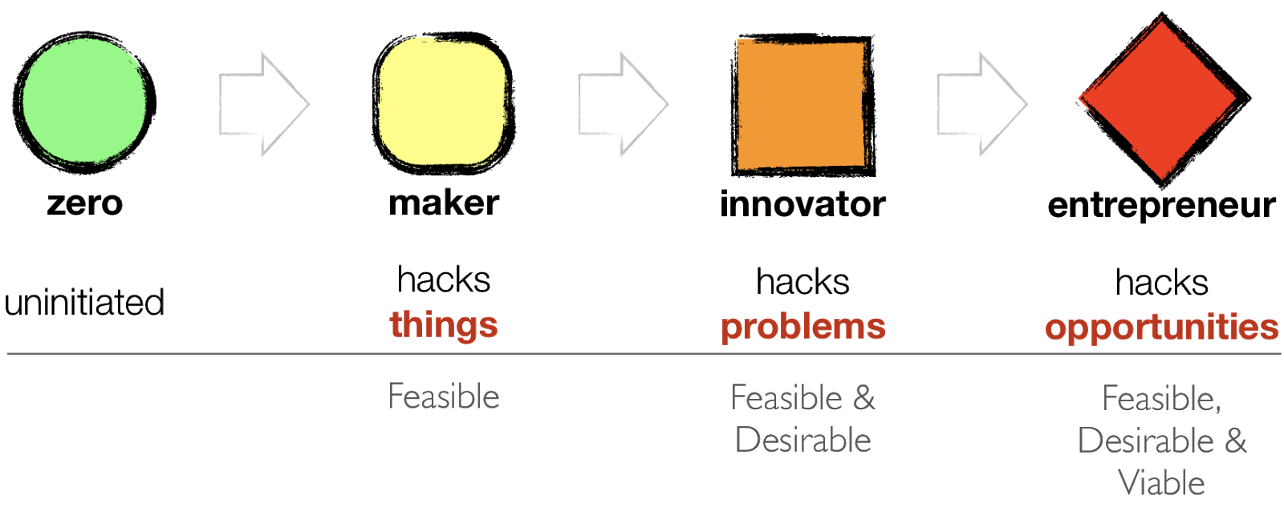
Zero2Maker is a project-based program to introduce school and university students to deation, creativity, and technology while building their confidence to learn on their own. It is based on the research by Prof. Rajesh Nair.
Prof. Rajesh Nair Professor. of Practice, Director of Innovation & Entrepreneurship Center, Asia School of Business, KL, Malaysia

Slide 3
Learning
Types of Sensors
Detection if Environment / Surrounding
Pinouts for connections
Analog / Digital

Slide 4
Types
Acoustic, sound, vibration
Automotive
Chemical
Electric current, electric potential, magnetic, radio
Environment, weather, moisture, humidity
Flow, fluid velocity
Ionizing radiation, subatomic particles
Navigation instruments
Position, angle, displacement, distance, speed, acceleration
Optical, light, imaging, photon
https://en.wikipedia.org/wiki/List_of_sensors

Slide 5
Types
11. Pressure
12. Force, density, level
13. Thermal, heat, temperature
14. Proximity, presence
15. Sensor technology
16. Speed sensor
17. Others
https://en.wikipedia.org/wiki/List_of_sensors

Slide 6
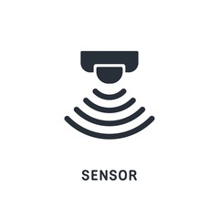

















Types
Distance
Motion
Colour
Pulse
Temperature
Humidity
Flow
Fingerprint
Soil Moisture
Touch
Sound
PH
Pressure
RFID.
Light
Gyro
Acclero
Rain
Notes:
Distance
Distance motion કલર પલ્સ ટેમ્પરેચર યુનિટી લો ફિંગર પ્રિન્ટ ટચ

Slide 7




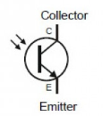







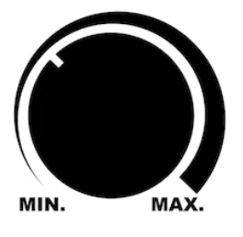
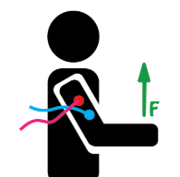




Types
Tilt
Gas
Joystick
Flame
IR Detection
Voltage
Dust
ECG
Flex
Weight
IR Receiver
Camera
Potentiometer
Muscle
Vibration
Metal
Location
PizzoElectric

Slide 8
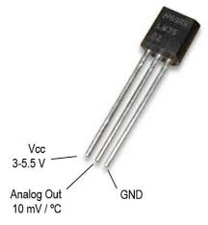
LM35 TEMPERATURE SENSOR
Temperature sensor outputs temperature given power as input, there are multiple grade temperature sensors available. Depicted in picture the temperature sensor is LM35. The LM35 series of devices are precision-based integrated-circuit temperature devices with an output voltage, which is linearly proportional to the Centigrade temperature. LM35 is a three terminal linear temperature sensor which can measure temperature from -55 degree Celsius to +150 degree Celsius.
Z2M Part No : EMS-008-A

Slide 9
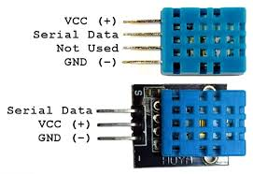
DHT 11 HUMIDITY SENSOR
Humidity sensor is a sensor used to sense the relative humidity of environment in its proximity. Modern day commonly available sensors of DHT series (DHT11 and DHT22) measure the temperature along with relative humidity. Where, relative humidity (RH) is the amount of water vapour present in air expressed as percentage of the amount needed for saturation at the same temperature.
Z2M Part No : EMS-008-A

Slide 10
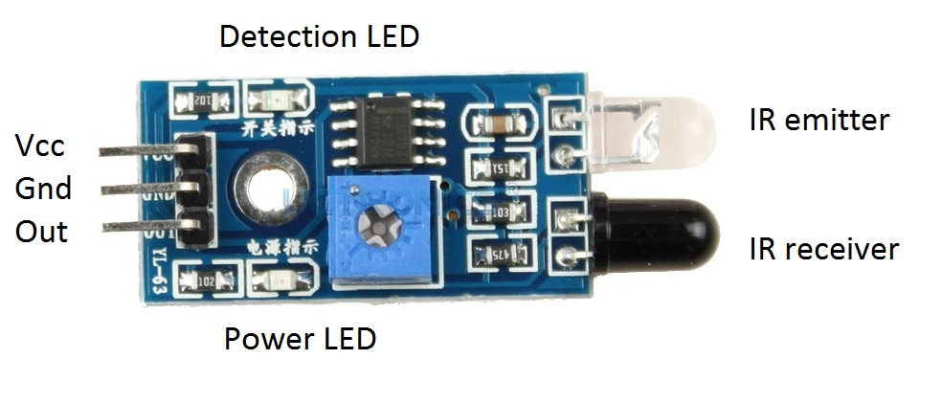
IR SENSOR
IR(Infrared Detector) is used to detect the object in its proximity. Along with this, it can also be used to detect the shade (Dark-Blackish or Light-Whitish) of an object under certain condition. They are inspired by pyrophilous (fire loving) insects. Being highly sensitive to infrared (IR) reception, they are able to detect forest fires at considerable distances. SImilarly, IR sensors work on the principle of reflection of light.
There are 2 crucial components in the IR module; the IR Transmitter (IR Tx-LED) and IR Receiver (IR Rx-Photodiode or Phototransistor). Even though an IR Tx LED looks like a normal LED, the radiation emitted by it is invisible to the human eye.
Z2M Part No : EMS-014-A

Slide 11
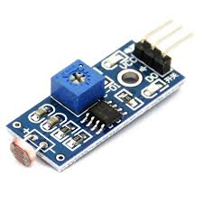
LDR SENSOR
A light dependent photoresistor(or LDR) is a light-controlled variable resistor which works on the principle of photoconductivity. As the principle suggests that, with the increase in light intensity, the resistance of the photo-resistor decreases and vice-versa.
Z2M Part No : EMS-019-A

Slide 12
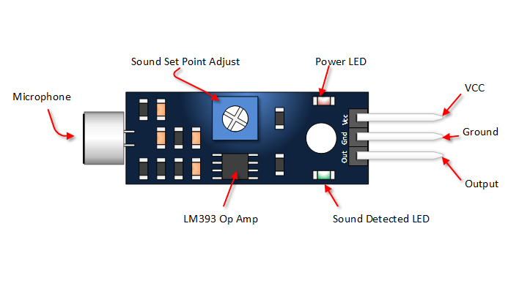
SOUND DETECTION SENSOR
The sound sensor, as the name suggests, is a type of module which is used to Detect the sound. Generally, it has been seen that this module is used to detect the intensity of sound. It makes use of a microphone to provide input to the buffer, peak detector and an amplifier. This sensor detects a sound, and produces an output voltage signal to a microcontroller.
Z2M Part No : EMS-004-B

Slide 13
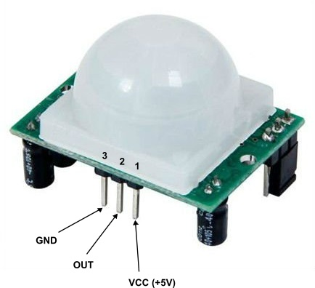
PIR SENSOR
A PIR (passive infrared) sensor is an electronic sensor that detects Infrared(IR) light radiating from objects in its field of view. They are most often used in PIR-based motion detectors.
PIR sensor is made of two slots which in turn are build by specific material that is
sensitive to IR. There is Fresnel lens which looks that two slots can see out some distance.
Z2M Part No : EMS-006-A

Slide 14
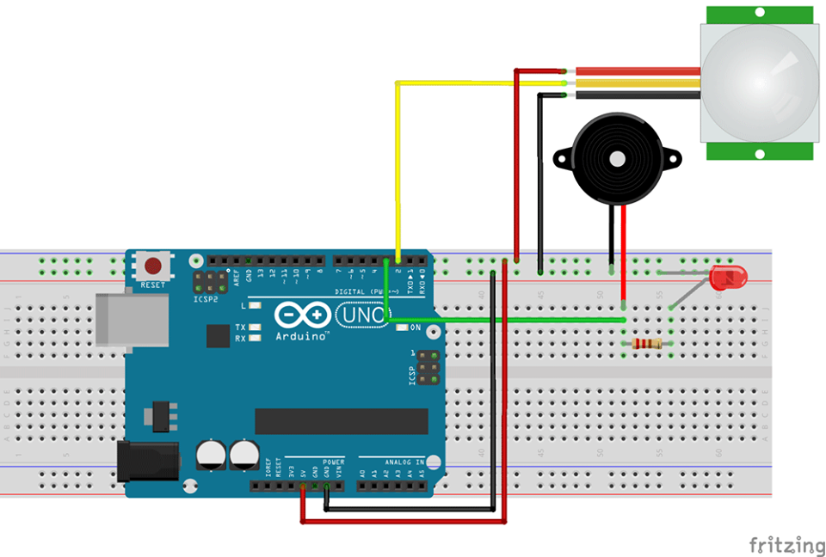
PIR Sensor
Buzzer
BreadBoard
Arduino Uno R3
Detect the movements and alert through buzzer

Slide 15
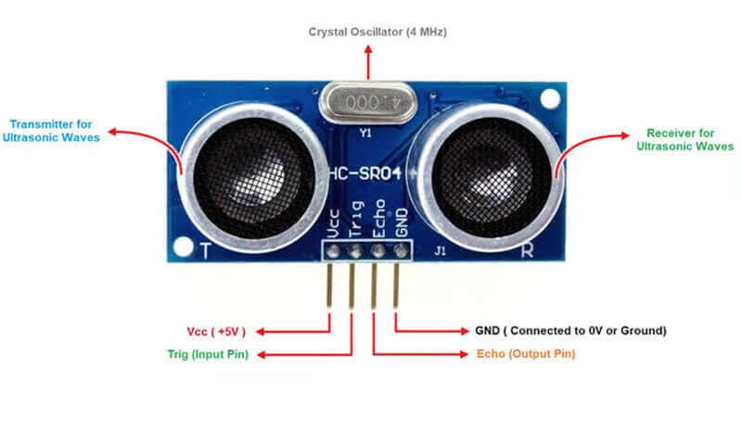
ULTRASONIC SENSOR
Ultrasonic sensor works in the way the bats do using echolocation. An Ultrasonic transmitter/receiver sensor is used to measure distance to an object by timing the delay of echo from the object after a signal has been transmitted. This integrated sensor shown here has two transducers, one is a transmitter sending sound pulse of frequency greater than 20kHz, while the other is a receiver which detects the reflected sound pulse and creates an electrical signal to estimate the distance.
Z2M Part No : EMS-005-A

Slide 16
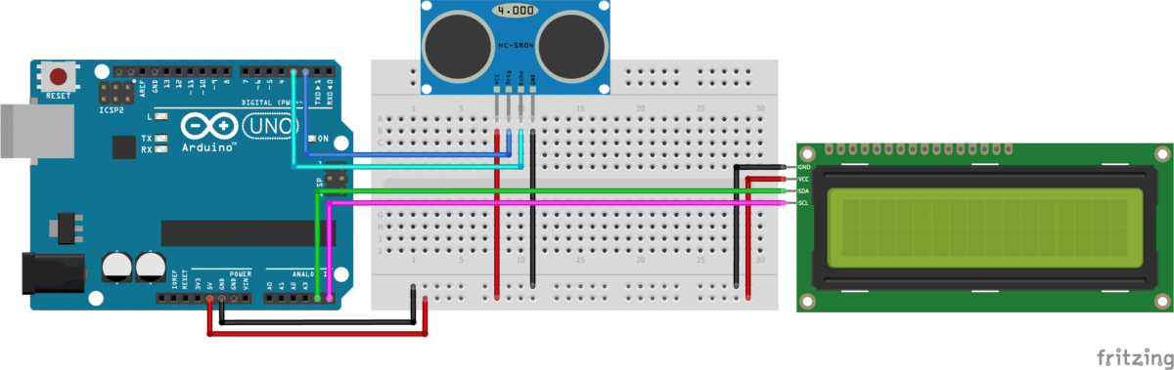
Distance : 15 CM
BreadBoard
Arduino Uno R3
Ultrasonic Sensor
Liquid Crystal Display
Measuring Distance and Displaying that on LCD

Slide 17
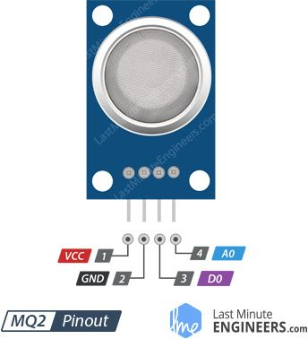
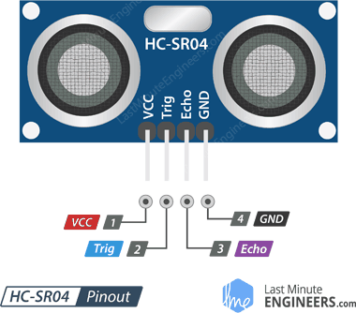
Pinout
https://lastminuteengineers.com/

Slide 18
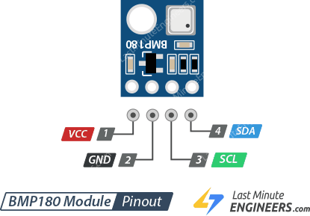
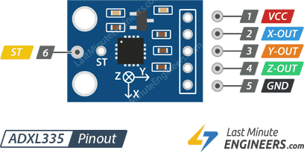
Pinout
https://lastminuteengineers.com/

Slide 19
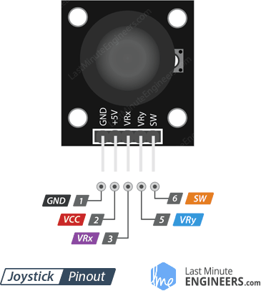
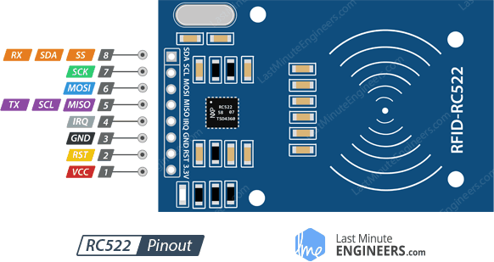
Pinout
https://lastminuteengineers.com/

Slide 20
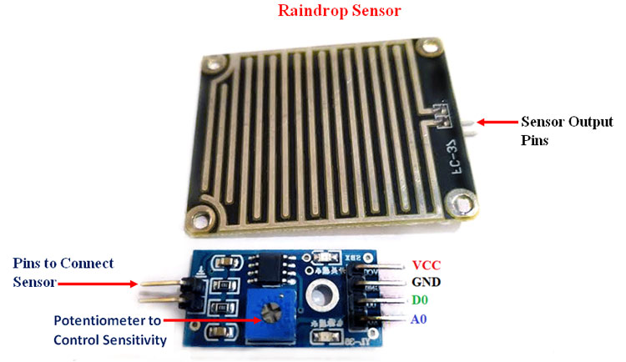
RAIN SENSOR
Rain sensor is a switching device that makes use of rainfall for activation purposes. The principle of the working of the rain sensor is that whenever it detects water, it automatically closes the switch. The main applications of the rain sensor are in water conservation devices in irrigations, keeping the interiors of the automobile safe form the moisture.
Z2M Part No : EMS-008-A

Slide 21
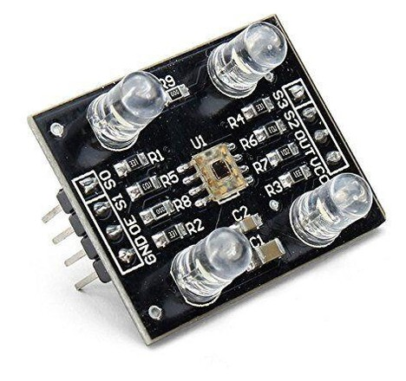
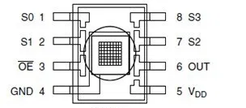
COLOR SENSOR
A color sensor has the ability to detect the color of the material. Usually the detection of the colors takes place in RGB scale. The RGB refers to the system of representation of colors which are to be used in the computer display. Individual color filters are evenly distributed thoughout the sensor array so as to eliminate any kind of location specific bias for color matching.
Z2M Part No : EMS-013-A

Slide 22
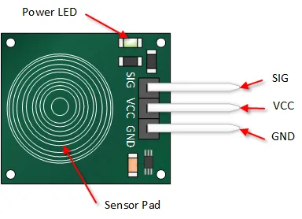
CAPACITIVE TOUCH SENSOR
A touch detector converts the capacitance of our body into a signal to detect finger touch. Capacitive touch sensors are found in common home appliances, automotive interface, and industrial applications. Touch sensors, unlike mechanical devices, does not comprise of any moving part. Hence, they are more durable than mechanical input devices. Touch sensors are robust as there are no openings for either humidity or dust to enter.
Z2M Part No : EMS-015-A

Slide 23
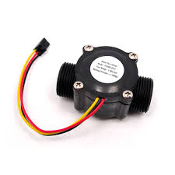
FLOW RATE SENSOR
Rate of flow of liquid is measured by flow sensor. It is built with a combination of water valve body, water rotor and a hall effect sensor. The difference in the flow causes the speed of the rotor to change and the corresponding change in output generated corresponding to the every pulse of the rotor is conveyed using the hall effect sensor.
Z2M Part No : EMS-017-A

Slide 24
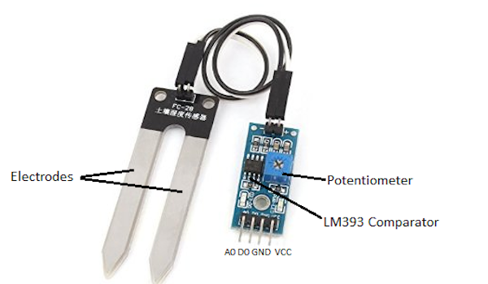
SOIL MOISTURE SENSOR
Soil sensor detects the volumetric water content in soil. It does so by measuring the electrical resistance, dielectric constants and neutron interaction. Since water is a good conductor, the water molecules when present in soil makes the sensor conductive when exposed to moisture thus decreasing the resistance. So it means the lesser the resistance or the output value of sensor, the water content will more be and vice versa.
Z2M Part No : EMS-021-A

Slide 25
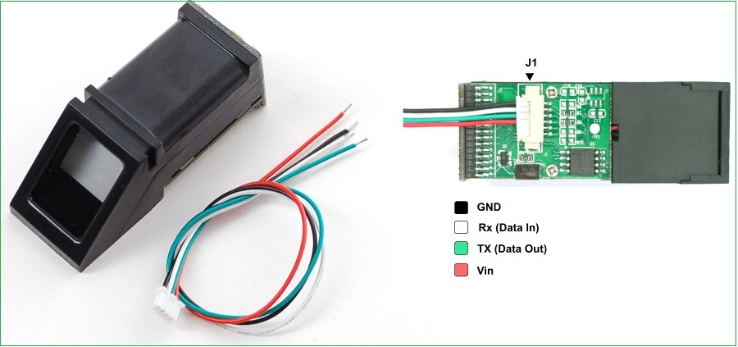
FINGERPRINT SENSOR
Fingerprint module enrolls new fingerprints, process them in terms of image, store print images, match with another prints stored. It includes Digital Signal Processing chip which takes the load of renders, calculation and such tasks. Any microcontroller can be attached to the sensor module with TTL serial mode.
Z2M Part No : EMS-___-A

Slide 26
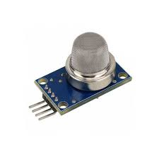
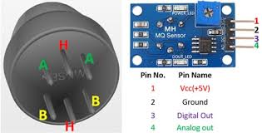
GAS SENSOR
Gas sensor module detects presence of gas in the area. Level of concentration is measured as each gas has it's particular breakdown voltage at which it is ionized. Sensor identifies gases by measuring these voltages.

Slide 27
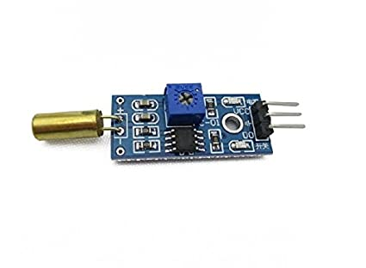
TILT SENSOR
A sensor which responds to the change in the angular movement of the body is called tilt sensor. The angular movement can be tilt, elevation, slope or depression. Tilt sensors are also called inclinometer. A tilt switch is basically a replica of pushbutton working in different physical mechanism.

Slide 28
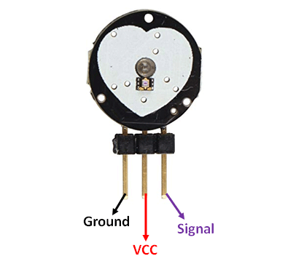
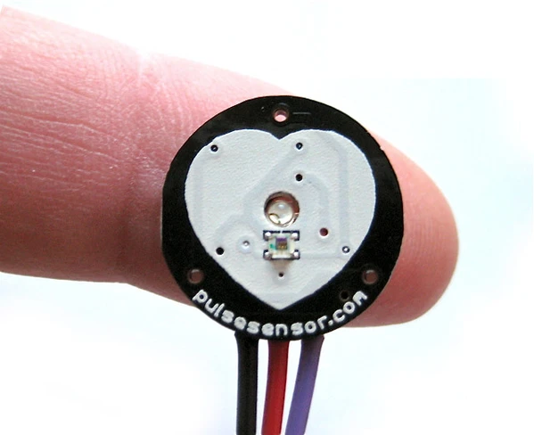
PULSE RATE SENSOR
Pulse Rate Sensor is a Plug and Play heart rate sensor which has a light embedded in it. This light is reflected by the expansion of capillary blood vessels. This in turn is used to identify the pulse rate of the person.

Slide 29
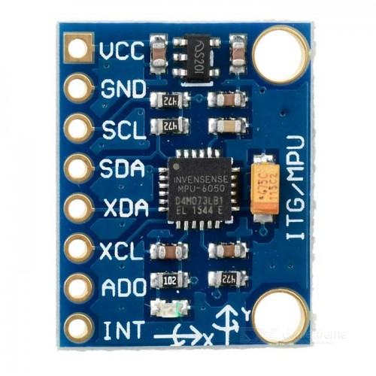
ACCELEROMETER
Accelerometer measures acceleration forces, a variety of accelerometers are available in the market such as peizoelectric accelerometer uses microscopic crystal that becomes stressed due to accelerative forces. These crystals create voltage from stress and the accelerometer system manipulates the voltage to determine velocity and orientation.

Slide 30
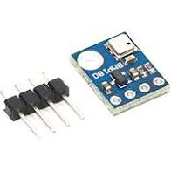
ATMOSPHERIC PRESSURE SENSOR
To predict weather, detect altitude even measuring vertical velocity, certain atmospheric pressure sensors are used. It's called barometric pressure sensor as it measures barometric pressure, ie the pressure caused by the weight of air pressing down on the Earth.

Slide 31
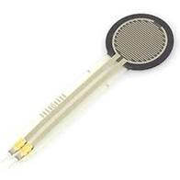
FORCE PRESSURE SENSOR
Force Pressure Sensor is just a resistance which changes upon applying force to the sensor. The resistance can go above 1MΩ when no force is applied, on the other hand, the value goes down when the force is applied.

Slide 32
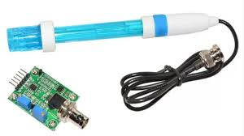
pH SENSOR
pH sensor module has a rod like structure with a bulb at bottom. The bulb is selective to hydrogen-ion concentration. Electrochemical Potential is created by these hydrogen ions on the bulb when the rod is immersed in the solution. This potential helps to identify the pH units using scientific methods.

Slide 33
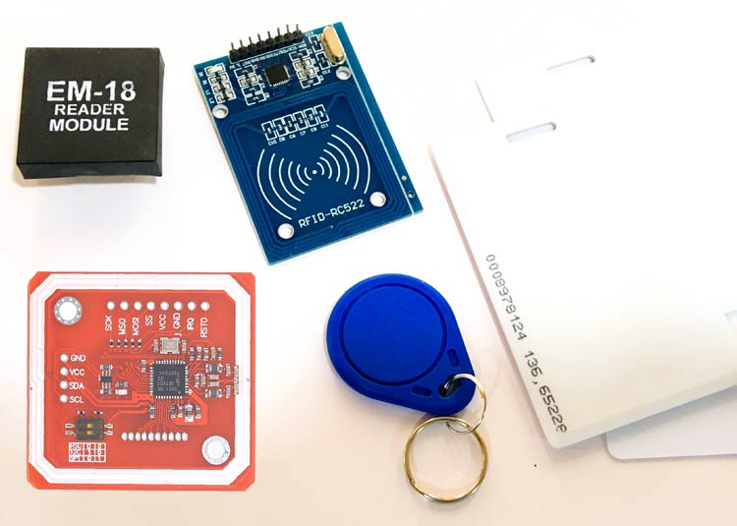
RFID MODULE
Electromagnetic fields are used in RFID module communication, what we generally use with Arduino are Passive type RFIDs which are triggered by electromagnetic pulse of the RFID receiver. On the other hand, Active RFIDs have battery attached to them.

Slide 34
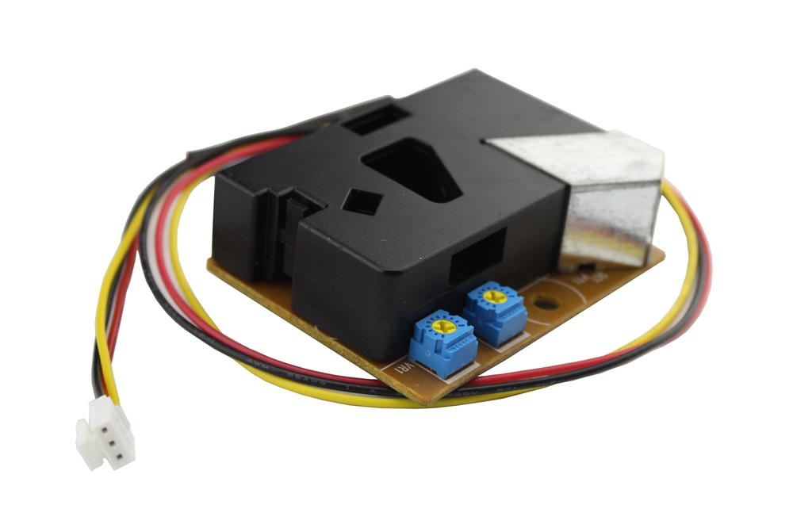
DUST SENSOR
Optical sensing method is equipped in Dust Sensor. The sensor contains IR LED whose light is bounced back from the dust particle, and the reflected light is sensed by the photo sensor inside the sensor module.

Slide 35
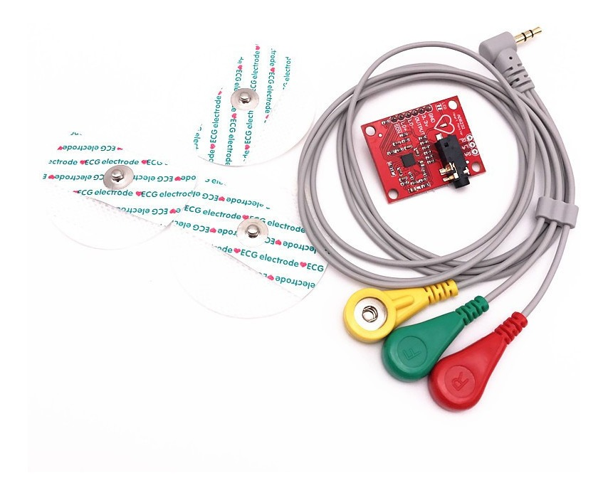
ECG MODULE
ECG module is used to measure the electrical activity of the heart. The data recorded can be charted and utilised for study. the module is taken in use with some additional cip to generate clear signal of the data input.

Slide 36
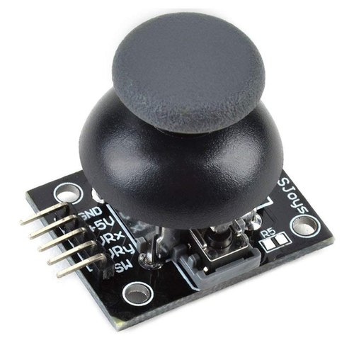
JOYSTICK MODULE
A joystick is a device to input x-y position coordinates into a computer. input device that rotates around a base. The angle at which it is rotated is reported to the device. For adding a low cost, game like feature to your system, joystick is one of that most affordable option. For X and Y measurements, the module has two potentiometers attached to it, Along with this, at top, an additional switch is attached to the module.

Slide 37
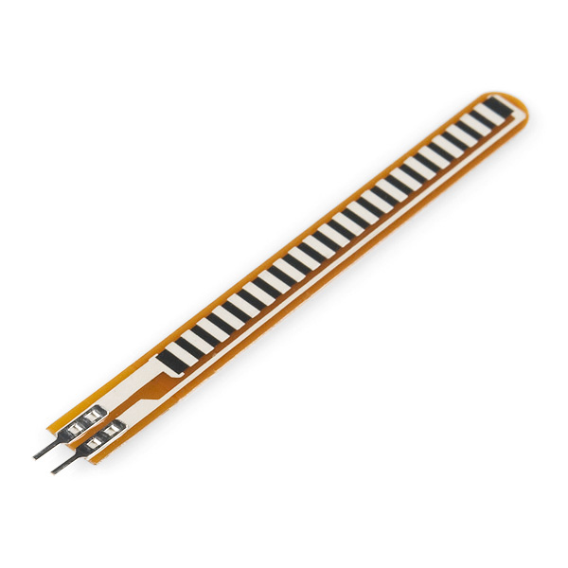
FLEX SENSOR
A flex sensor is a flexible potentiometer, that detects the amount (angle) of deflection or bending by proportionally varying its resistance. Generally, it is found to be unidirectional i.e. change in resistance occur in response to the bend or the particles motion in one particular direction.

Slide 38
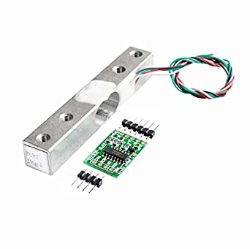
WEIGHT SENSOR
Weight Sensor or Load Cell is the transducer which transforms fore or pressure applied to it into electrical output. Inside them, cells have starin gauges which changes their shape when pressure is applied on them, which in turn changes their internal resistance thus changes the electrical output for usage.

Slide 39
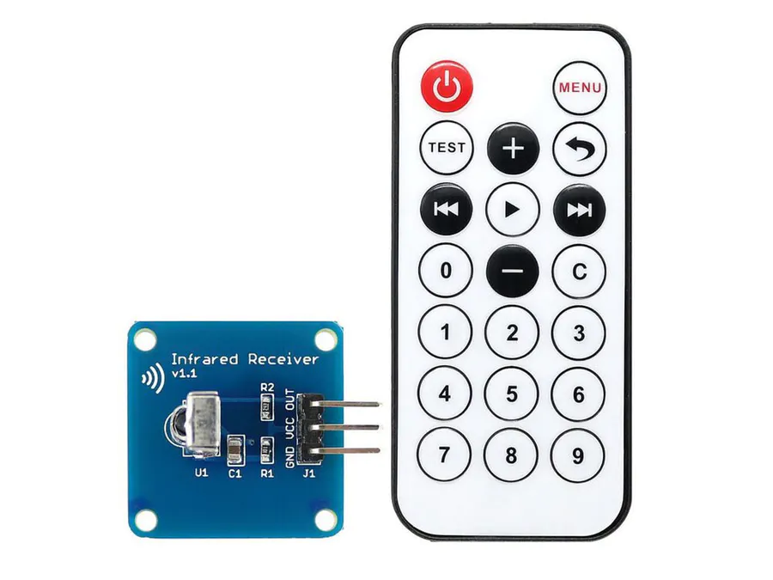
IR REMOTE
For IR communication, IR transmitter and IR receiver are the two crucial part of the working system. Although the IR transmitter may be similar as the normal LED but it produces light in IR spectrum. On the other side the receiver receives the signal, the circuit attached decodes that signal and uses it in the system.

Slide 40
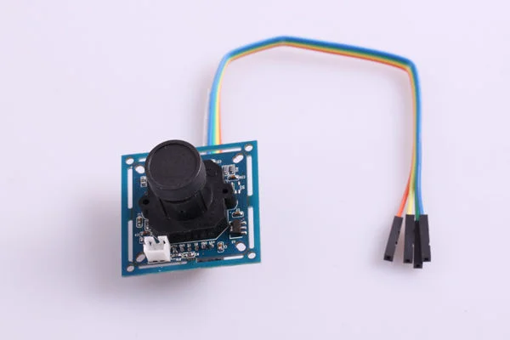
CAMERA MODULE
Camera module is a low end operating camera giving you basic functionalities to capture the image, obviously not in high Mega Pixels but it's good for learning.

Slide 41
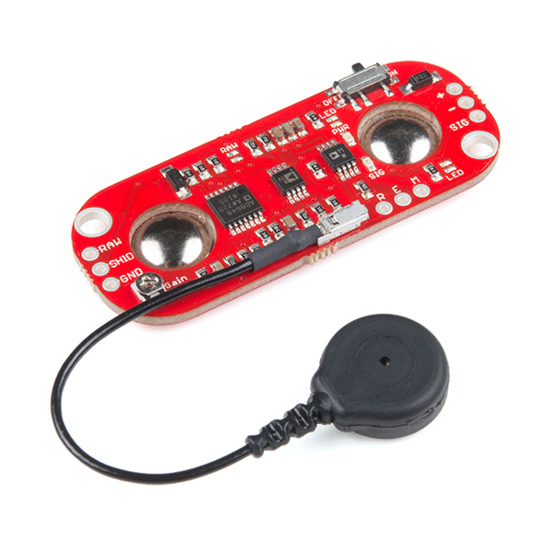
MUSCLE SENSOR
Electromyography is the concept which relates to the electrical potential of the muscle, the muscle sensors use this concept to judge the muscle activity. As whenever the muscle needs to flex, the brain sends electrical signal to muscle to start recruiting motor units. The muscle sensor will take in these electrical activities and output them into analog signal.

Slide 42
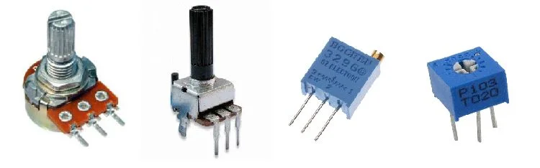
POTENTIOMETER
Potentiometer works on varying the sliding potion of the contact in order to change the resistance output. The output voltage is the voltage dip between fixed and sliding contact.

Slide 43




Share and support us to reach more makerspaces
Whatsapp Helpline
+91 8200532362
#zero2maker
www.encube.co
www.asb.edu.my
www.techtop.org

